Slide 1
OPERATING SYSTEMS
INTRODUCTION

Slide 2
WHY STUDY OPERATING SYSTEMS?
Although there are many practitioners of computer science, only a small percentage of them will be involved in the creation or modification of an operating system.
Why, then, study operating systems and how they work?
Simply because, as almost all code runs on top of an operating system, knowledge of how operating systems work is crucial to proper, efficient, effective, and secure programming.
Understanding the fundamentals of operating systems, how they drive computer hardware, and what they provide to applications is not only essential to those who program them but also highly useful to those who write programs on them and use them.

Slide 3
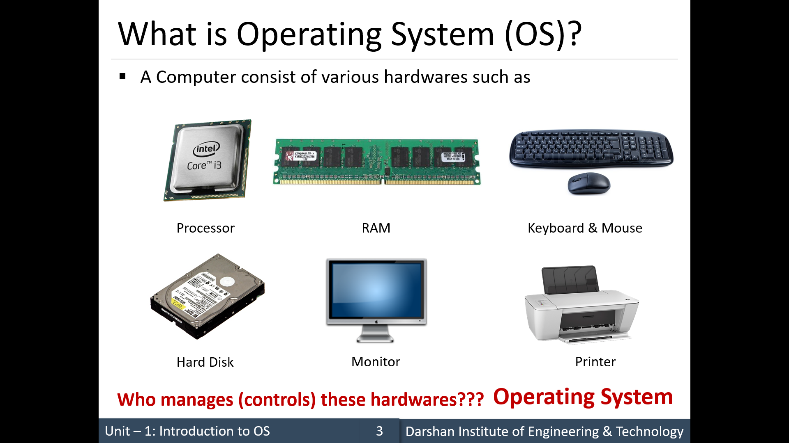

Slide 4
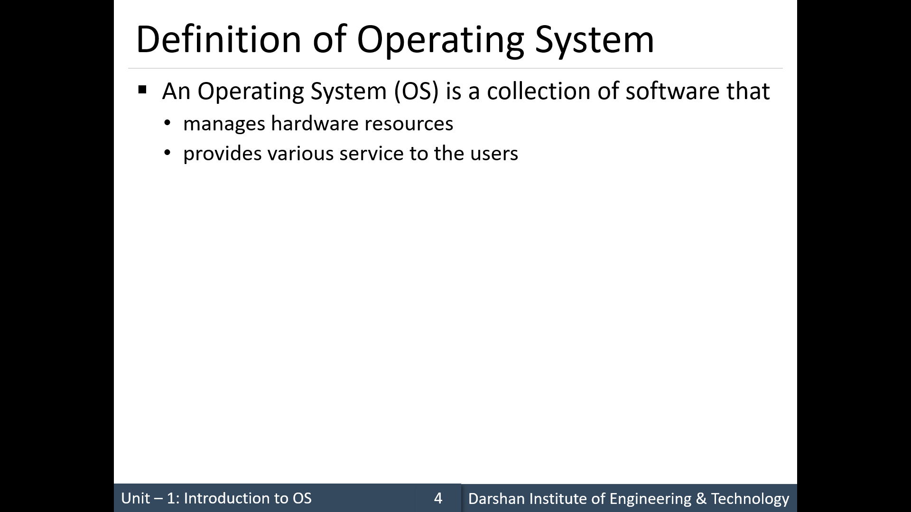

Slide 5
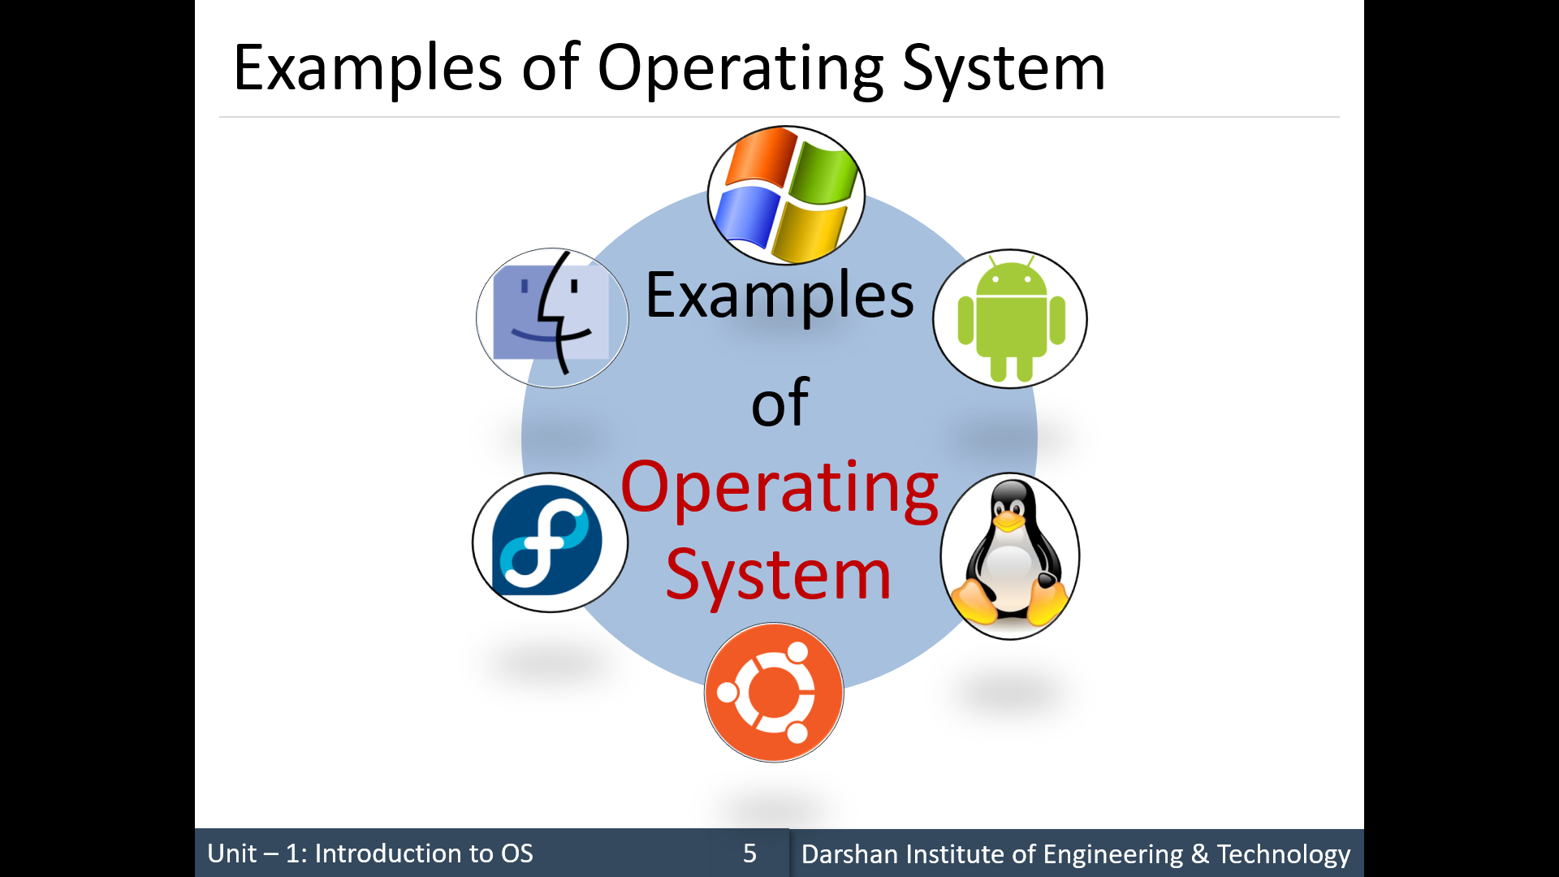

Slide 6
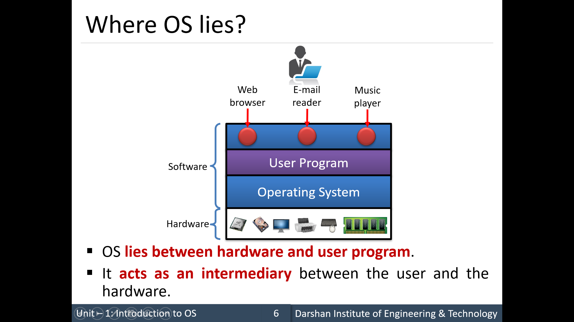

Slide 7
Objectives of Operating Systems
Operating system goals:
Execute user programs and make solving user problems easier
Make the computer system convenient to use
Use the computer hardware in an efficient manner

Slide 8
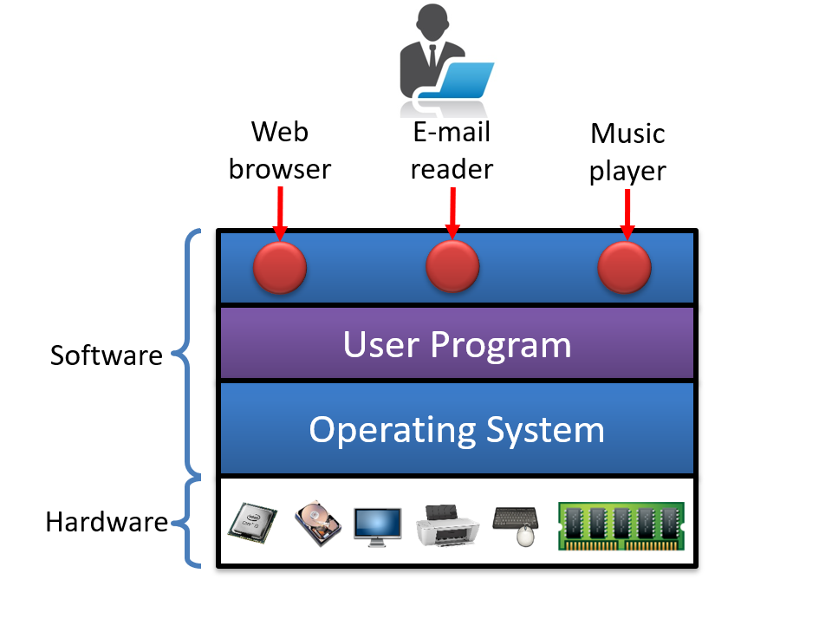
Computer System Structure
Computer system can be divided into four components
Hardware – provides basic computing resources
CPU, memory, I/O devices
Operating system
Controls and coordinates use of hardware among various applications and users
Application programs – define the ways in which the system resources are used to solve the computing problems of the users
Word processors, compilers, web browsers, database systems, video games
Users
People, machines, other computers

Slide 9
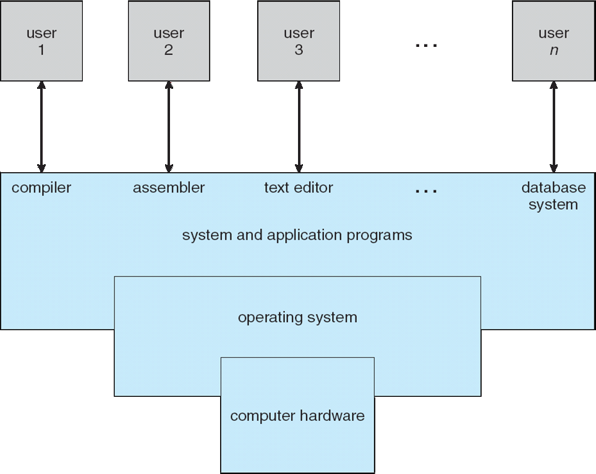
Four Components of a Computer System

Slide 10
Operating System Definition
The fundamental goal of computer systems is to execute programs and to make solving user problems easier.
Computer hardware is constructed toward this goal.
Since bare hardware alone is not particularly easy to use, application programs are developed.
These programs require certain common operations, such as those controlling the I/O devices.
The common functions of controlling and allocating resources are then brought together into one piece of software: the operating system

Slide 11
Operating System Definition
A more common definition, is that the operating system is “the one program running at all times on the computer” - usually called the kernel.
The kernel is the central module of an operating system (OS).
It is the part of the operating system that loads first, and it remains in main memory.
Typically, the kernel is responsible for memory management, process management, file management, and disk management.

Slide 12
Operating System Definition
The kernel connects the system hardware to the application software.
Every operating system has a kernel.
For example the Linux kernel is used numerous operating systems including Linux, FreeBSD, Android and others.
Along with the kernel, there are two other types of programs:
System Software:
System programs(system software), which are associated with the operating system but are not necessarily part of the kernel.
System software is a collection of programs designed to operate, control and extend the processing capabilities of the computer. They interact with the hardware at basic level.

Slide 13
Operating System Definition
Even the operating system is considered as a system software.
Examples for system software:
device drivers, compilers, assemblers, interpreters and so on.
Application Software:
Application programs, which include all programs not associated with the operation of the system.
They are designed to satisfy a particular task of a particular environment.
Example :
database programs, word processors, web browsers and spreadsheets, payroll software, inventory management software etc.

Slide 14
Operating System Definition
OS is a resource allocator
Manages all resources
Decides between conflicting requests for efficient and fair resource use
OS is a control program
Controls execution of programs to prevent errors and improper use of the computer
Resources managed by OS include CPU cycles, memory, file storage, peripheral devices and network connections.

Slide 15
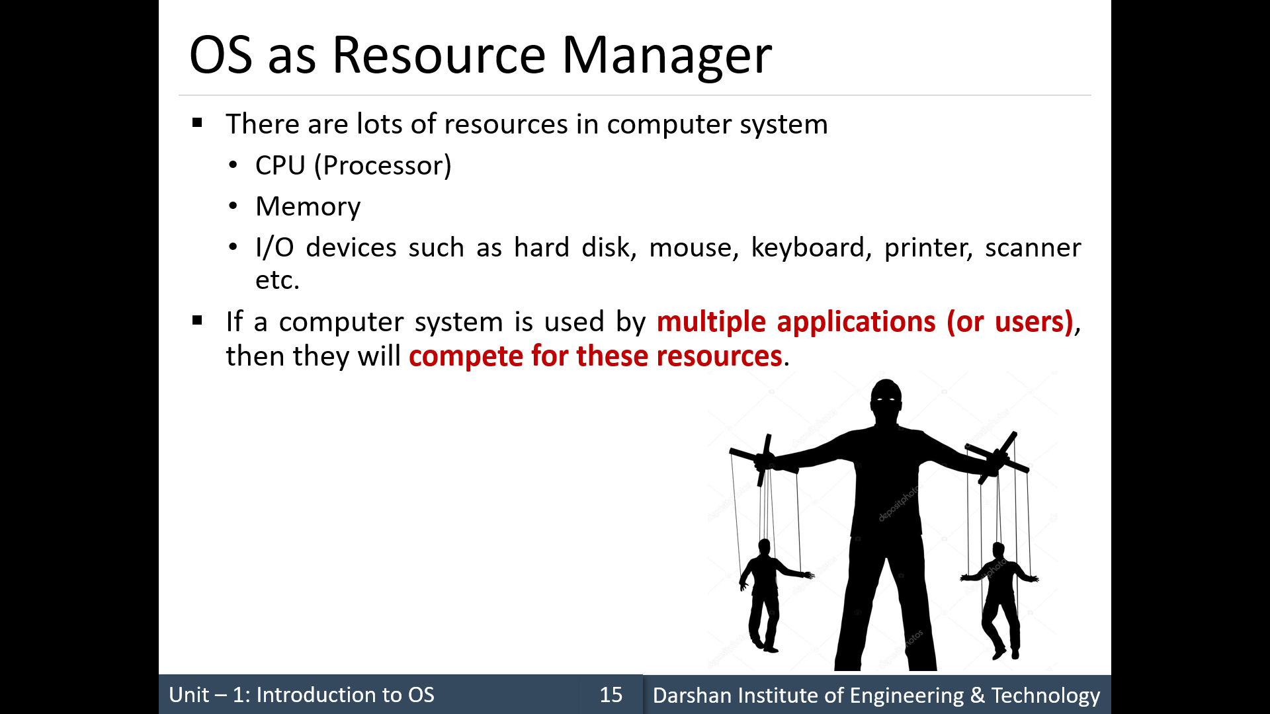

Slide 16
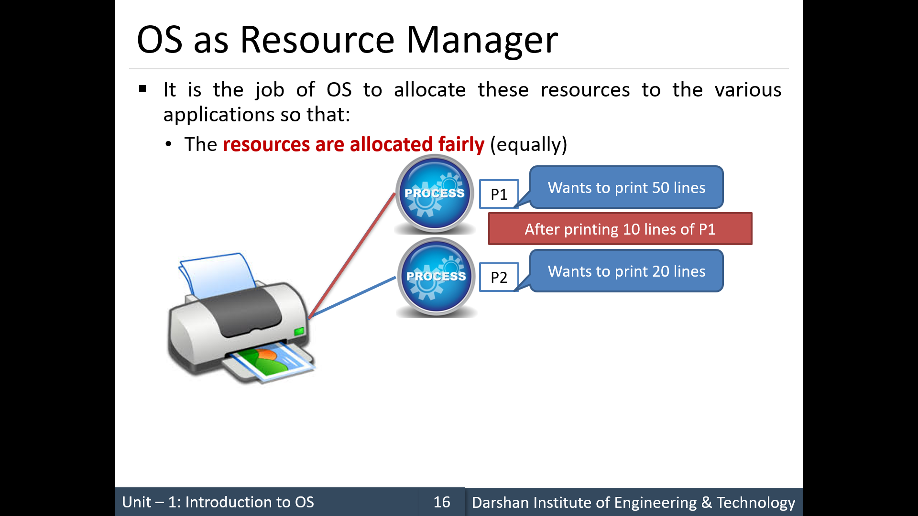

Slide 17
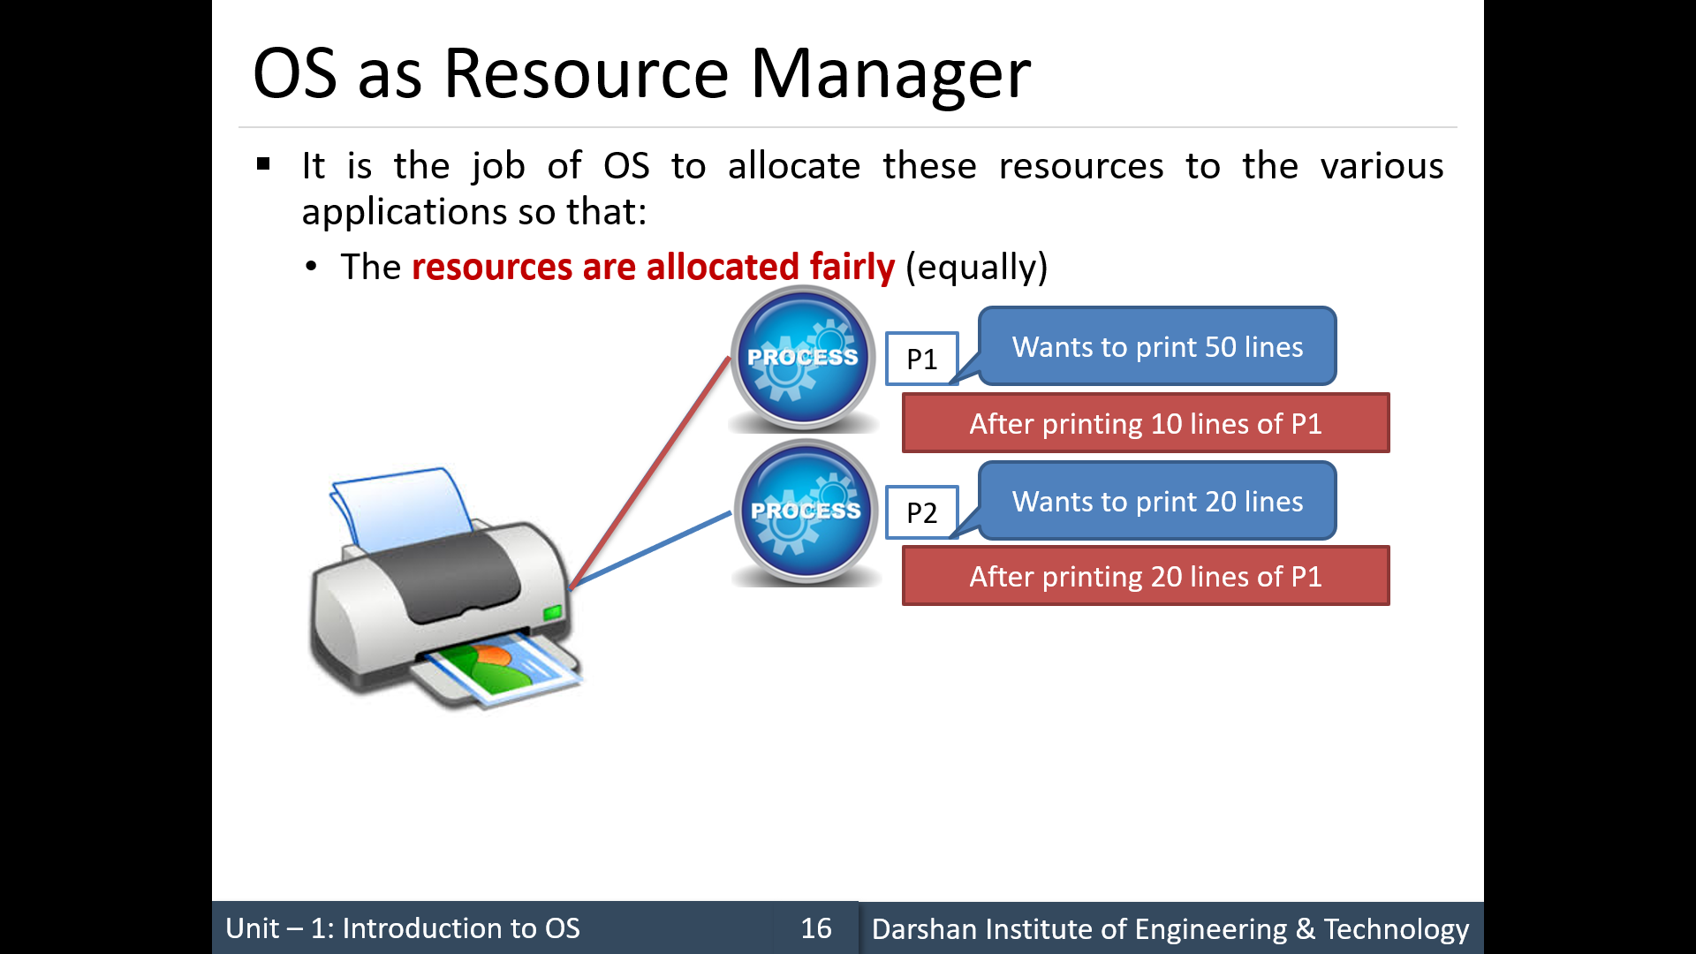

Slide 18
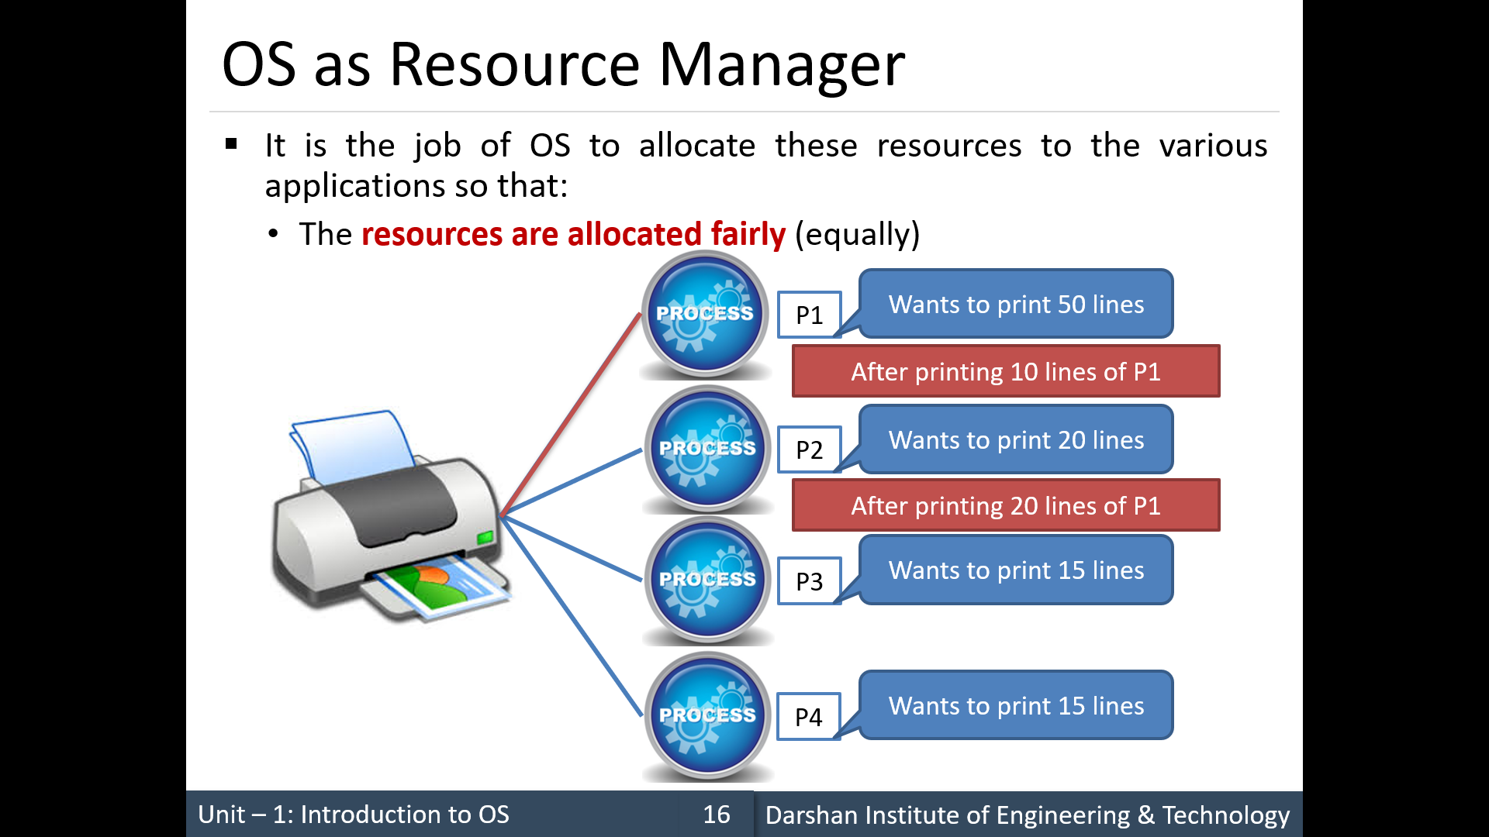

Slide 19
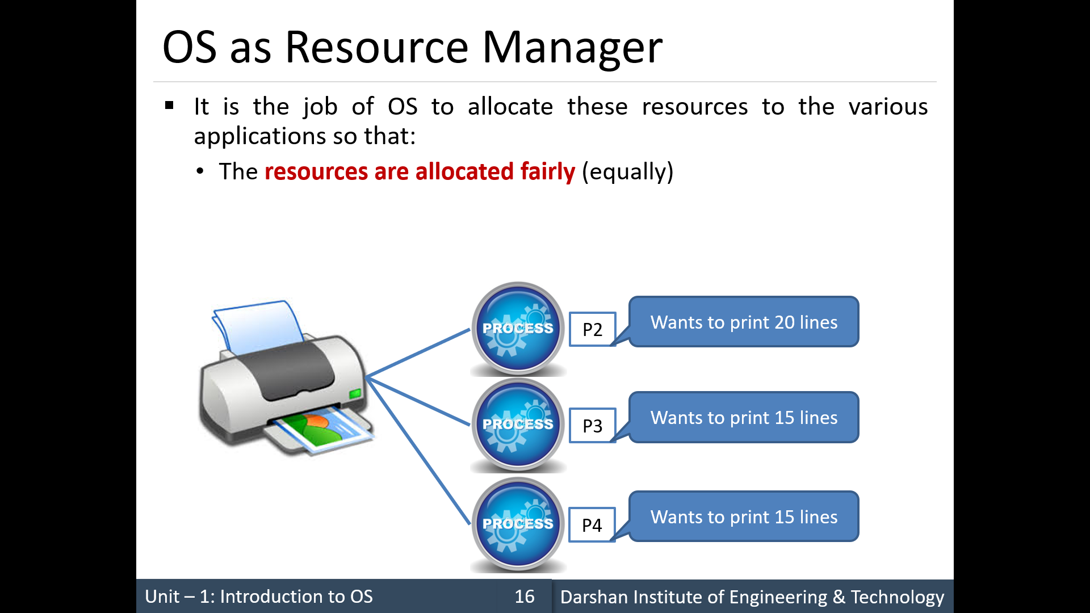

Slide 20
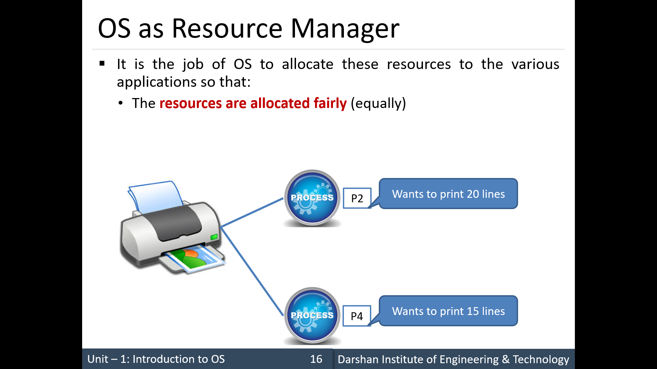

Slide 21
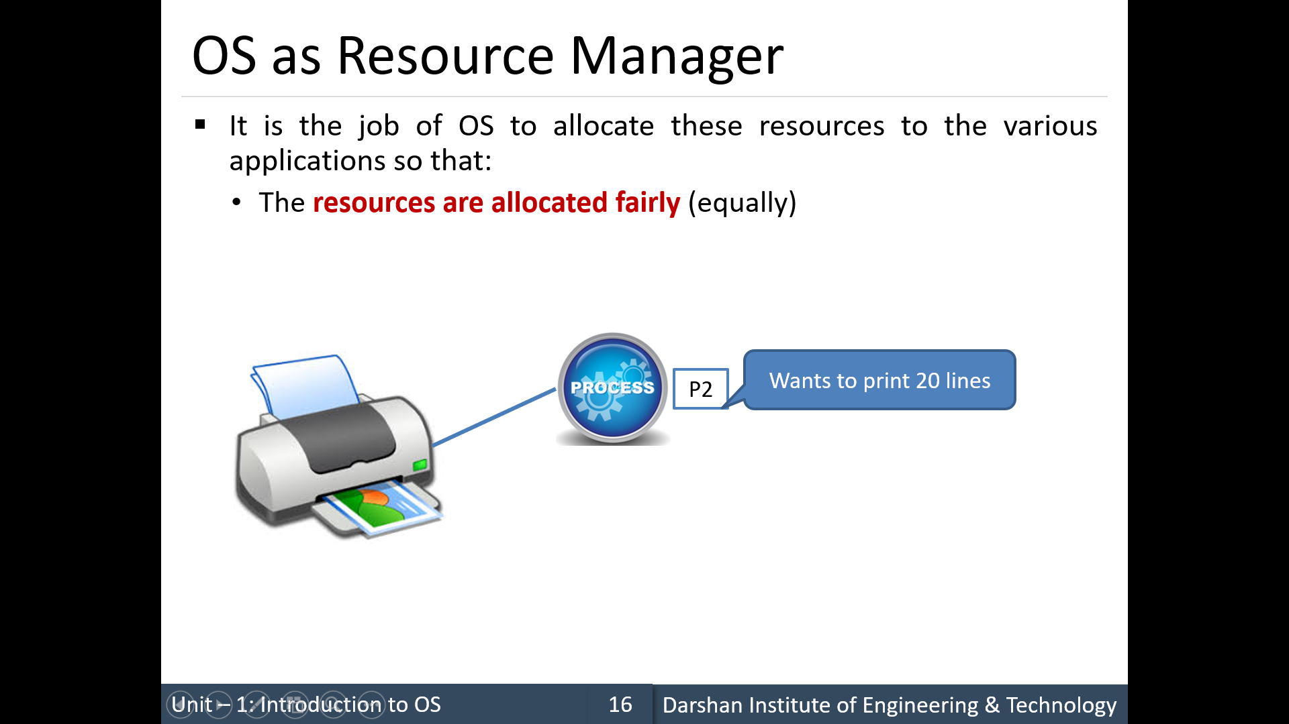

Slide 22


Slide 23
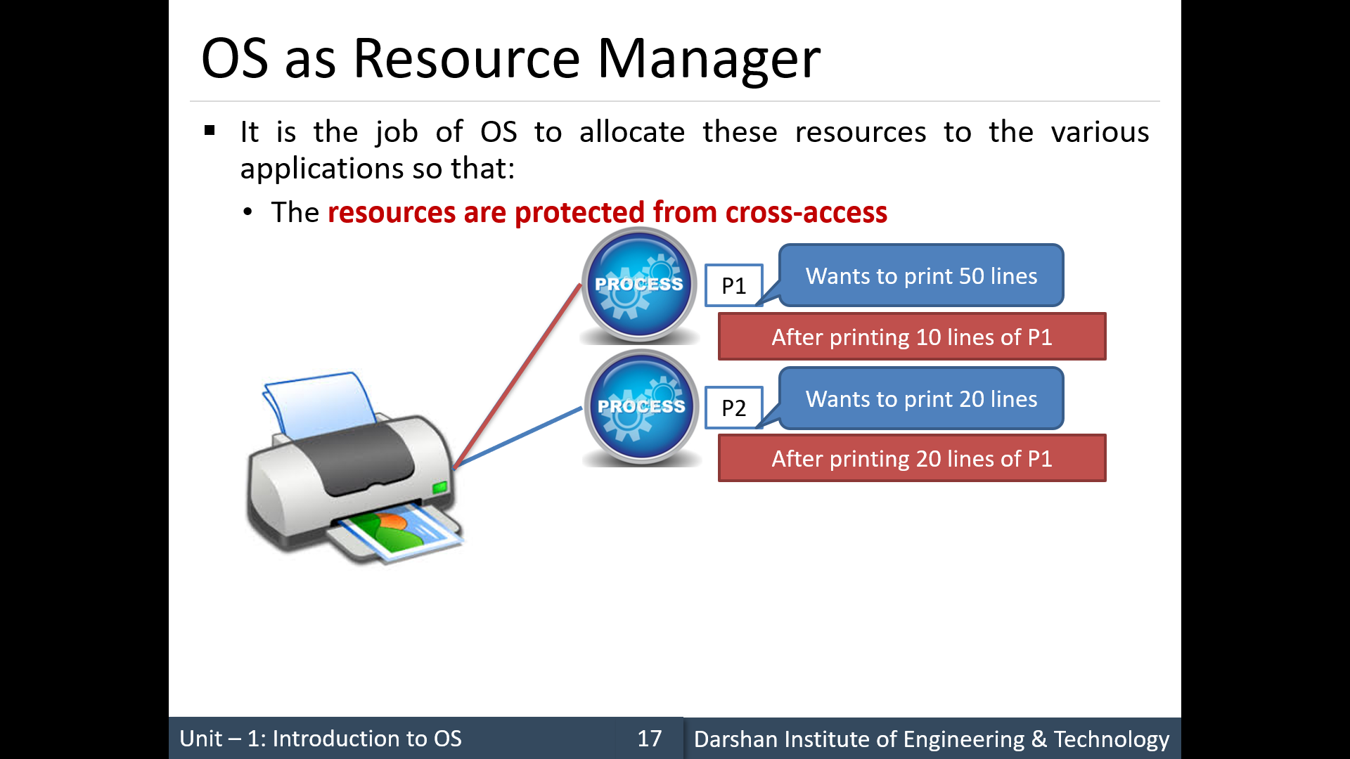
Control Program

Slide 24
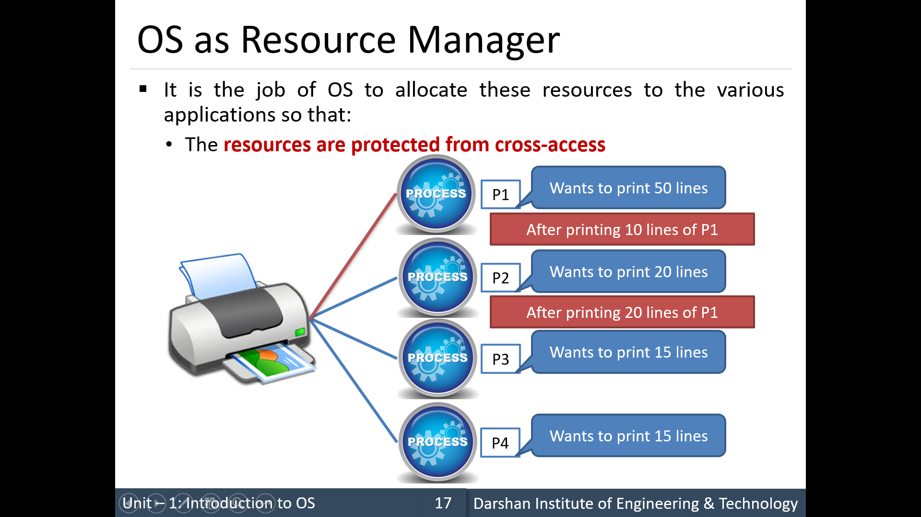
Control Program

Slide 25
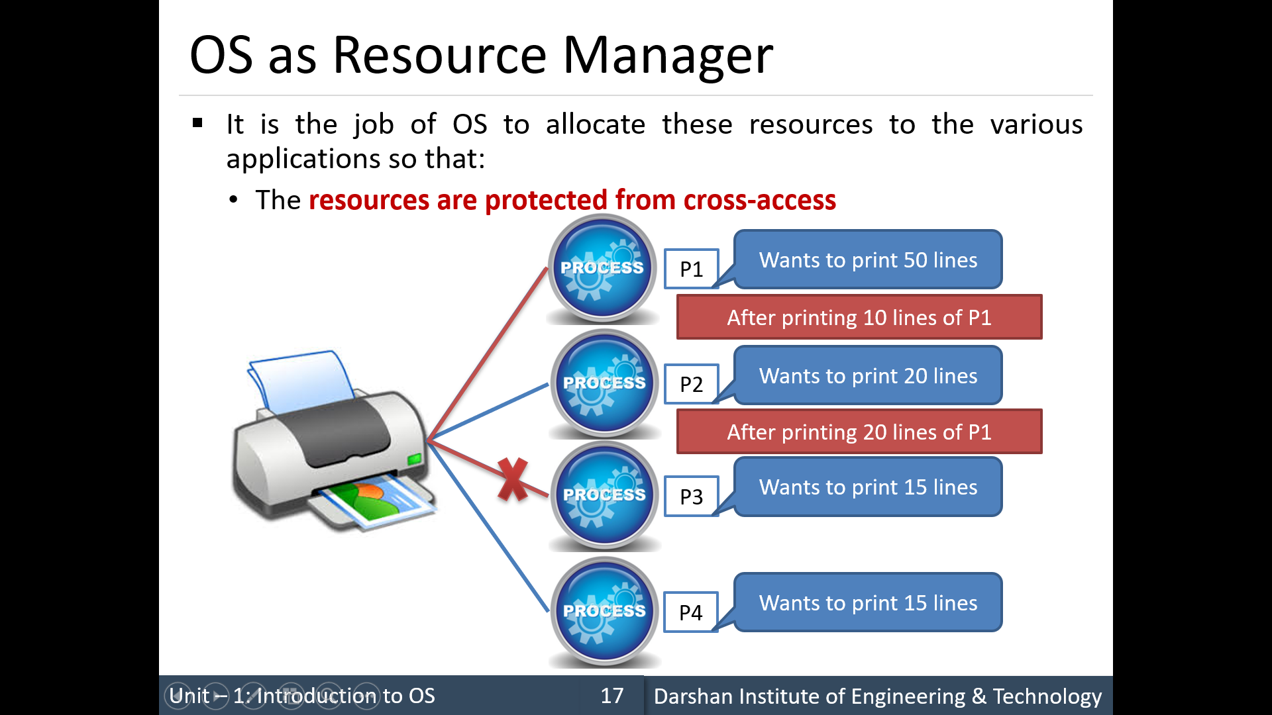
Control Program

Slide 26
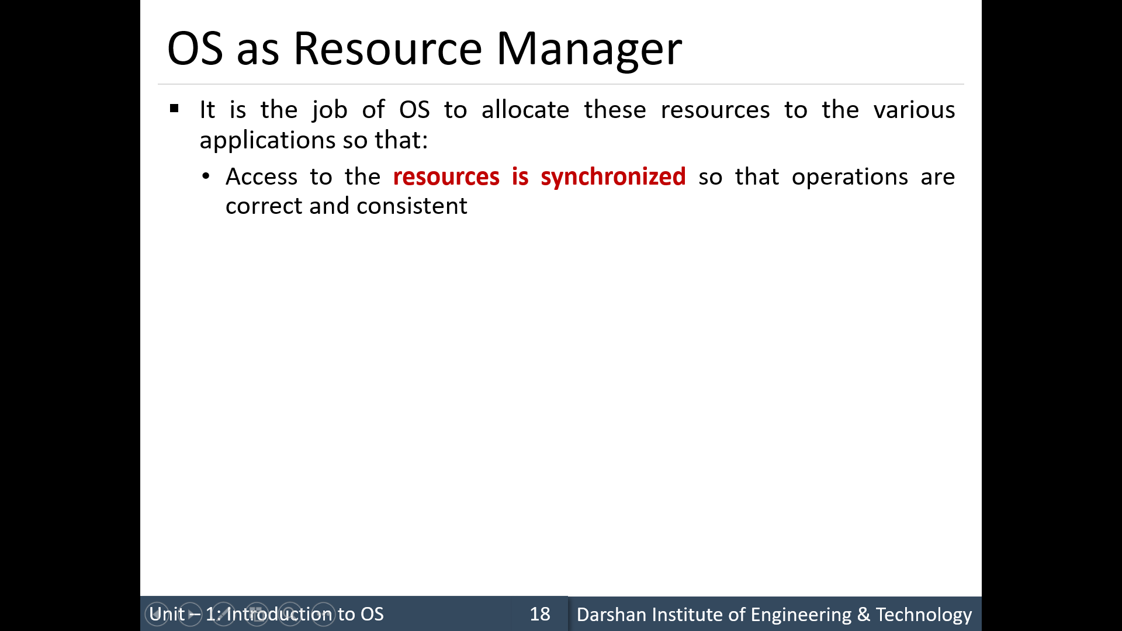
Control Program

Slide 27
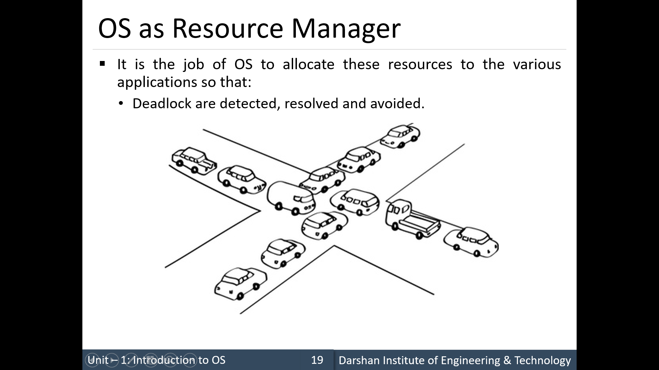

Slide 28
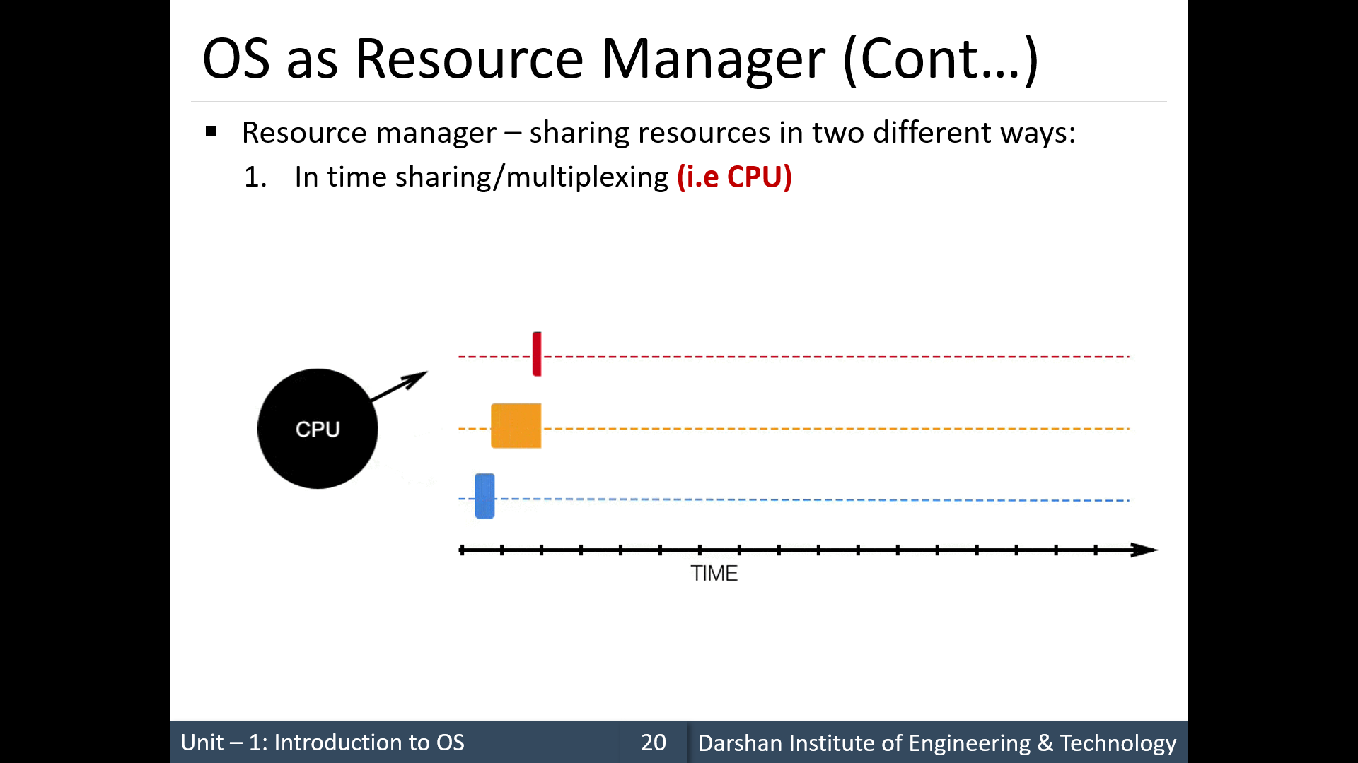

Slide 29
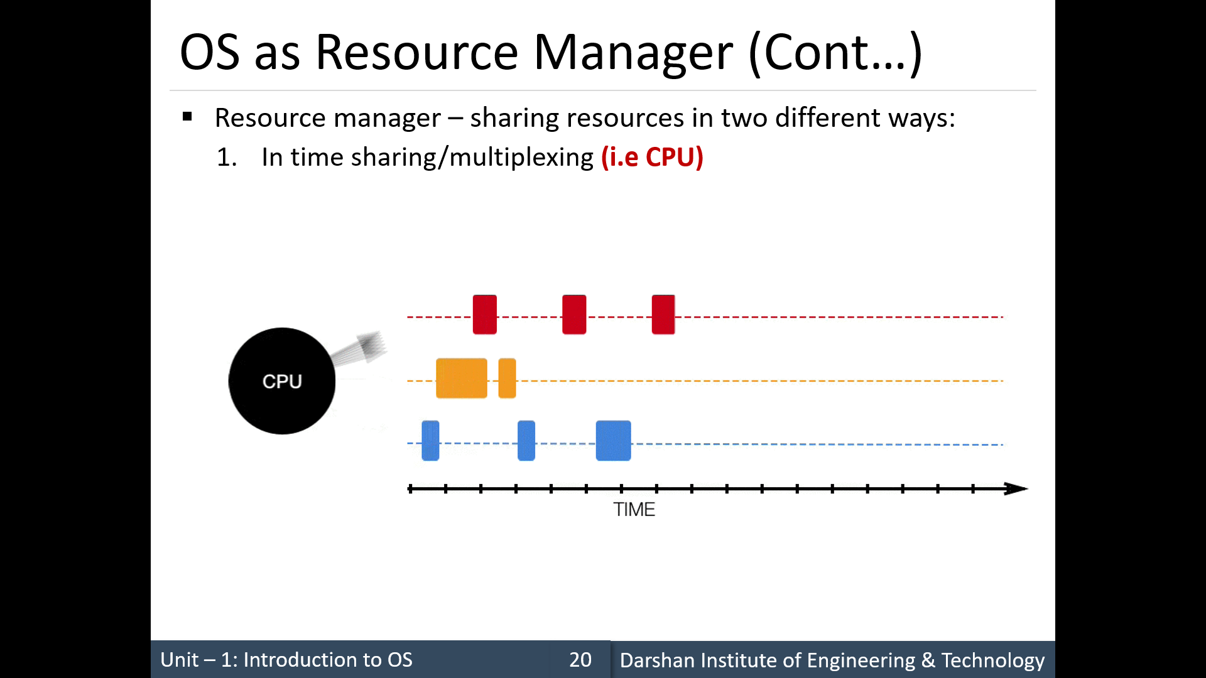

Slide 30
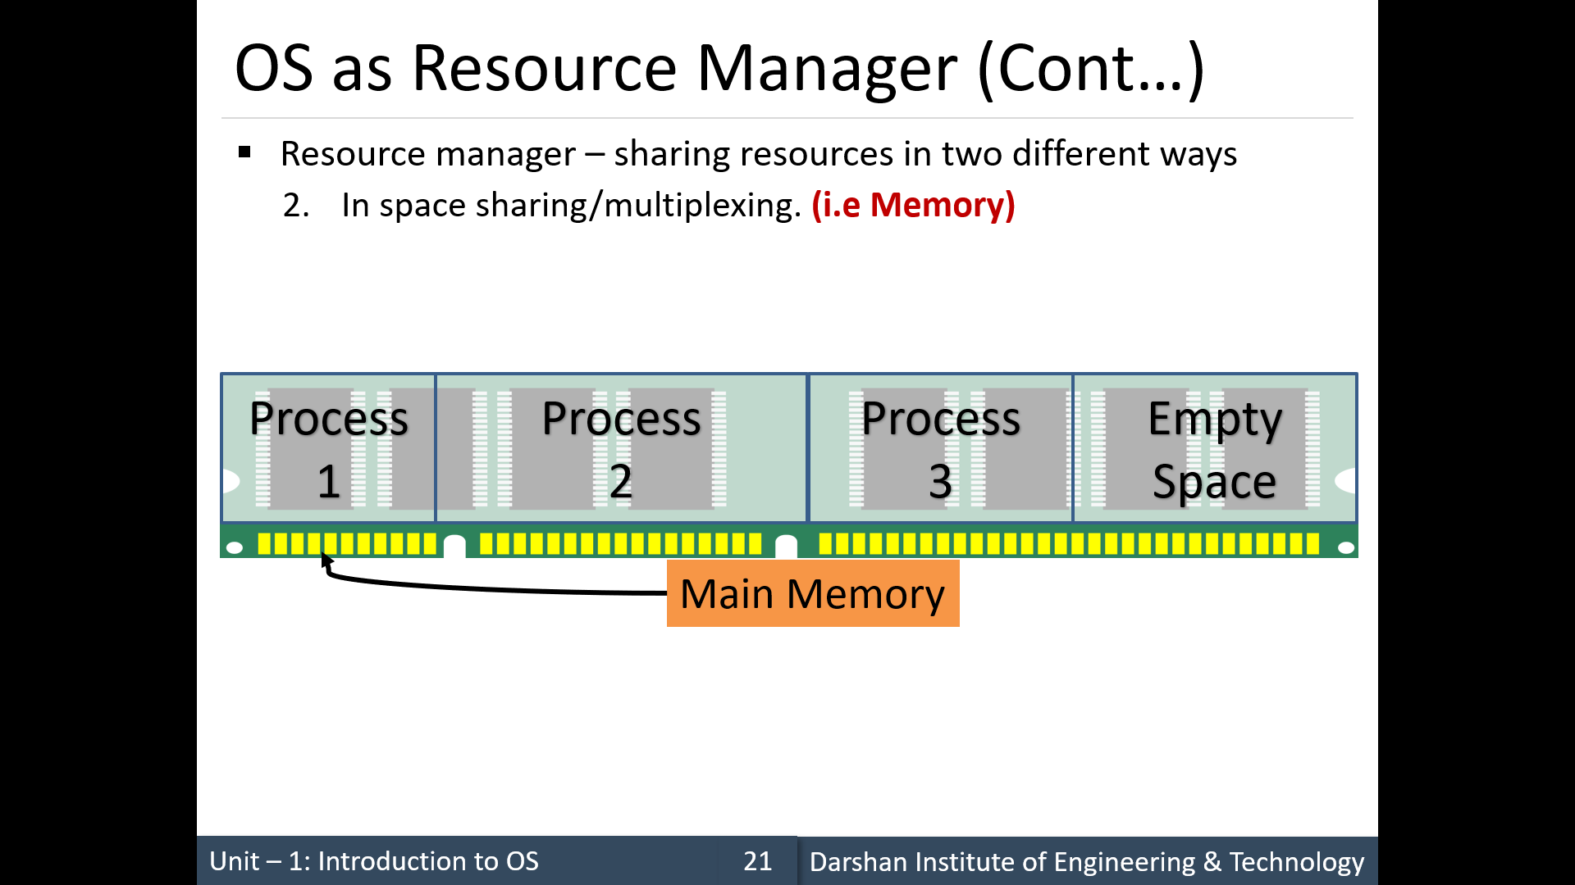

Slide 31
DEFINITIONS OF COMPUTER SYSTEM COMPONENTS
CPU—The hardware that executes instructions.
Many years ago, most computer systems used a single processor containing one CPU with a single processing core.
Core—The component that executes instructions and registers for storing data locally.
Multiprocessor—Including multiple processors.
More work done in less time.

Slide 32
DEFINITIONS OF COMPUTER SYSTEM COMPONENTS
Multicore—Including multiple computing cores on the same CPU.
Each core consists of independent processor with components, such as registers, ALU, pipeline hardware and control unit, plus cache memory.
Uses less power than multiprocessor environment.
Communication between cores is faster than between multiple processors
Although virtually all systems are now multicore, we use the general term CPU when referring to a single computational unit of a computer system and core as well as multicore when specifically referring to one or more cores on a CPU.

Slide 33
Symmetric multiprocessing architecture

Slide 34
A dual-core design with two cores on the same chip

Slide 35
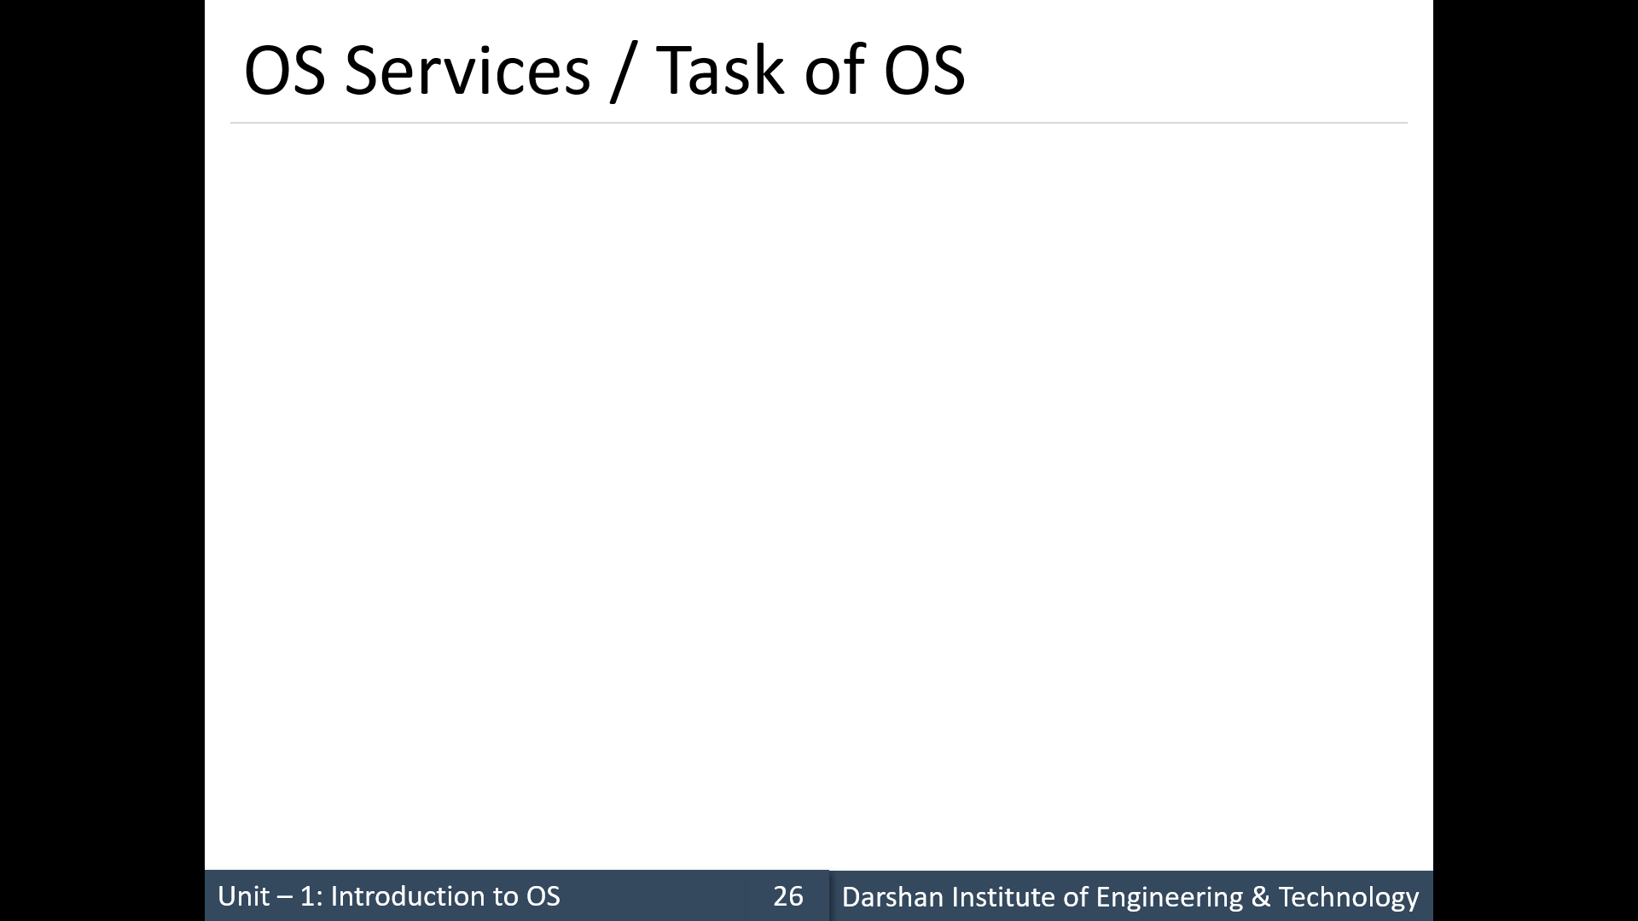
Functions
An operating system provides an environment for the execution of programs.
It makes certain services available to programs and to the users of those programs.
One service provided by OS is User interface.
This interface can take several forms.
a graphical user interface (GUI)
touch-screen interface
command-line interface (CLI),
Some systems provide two or all three of these variations.
The other functions of OS are:

Slide 36
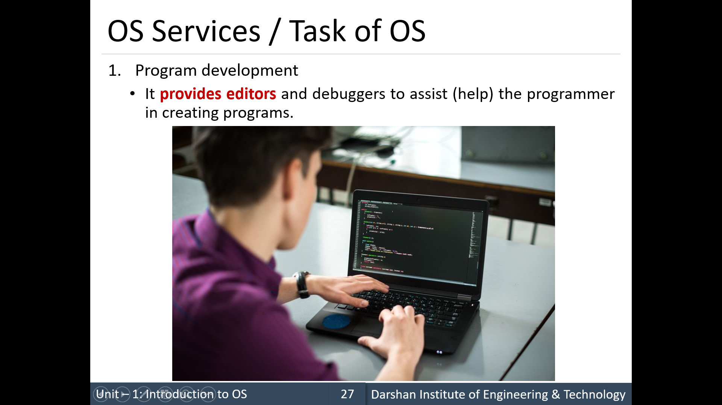
Functions

Slide 37
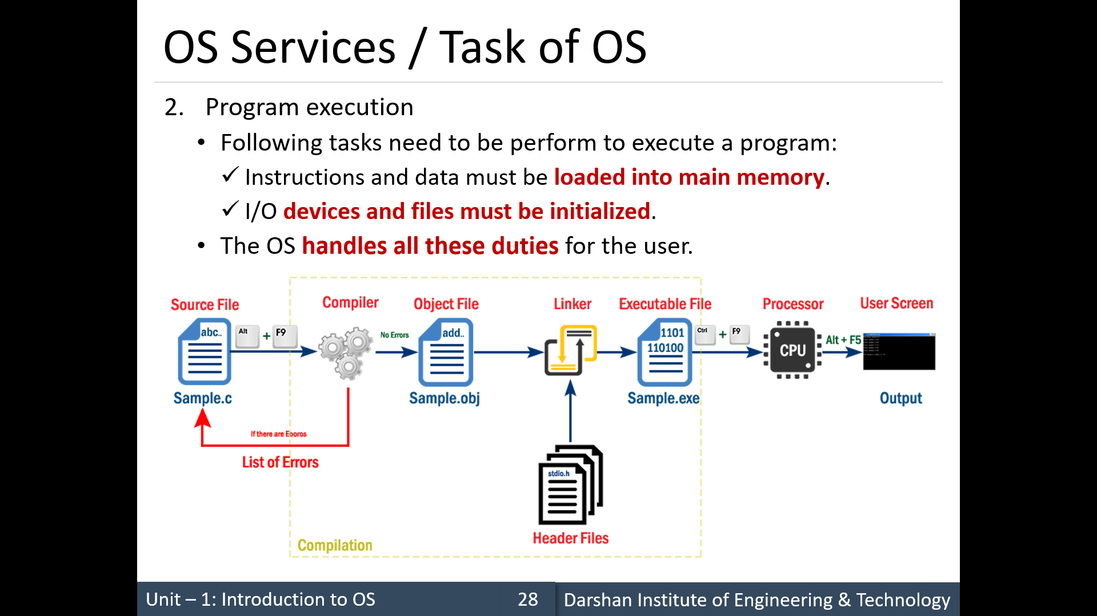
Functions

Slide 38
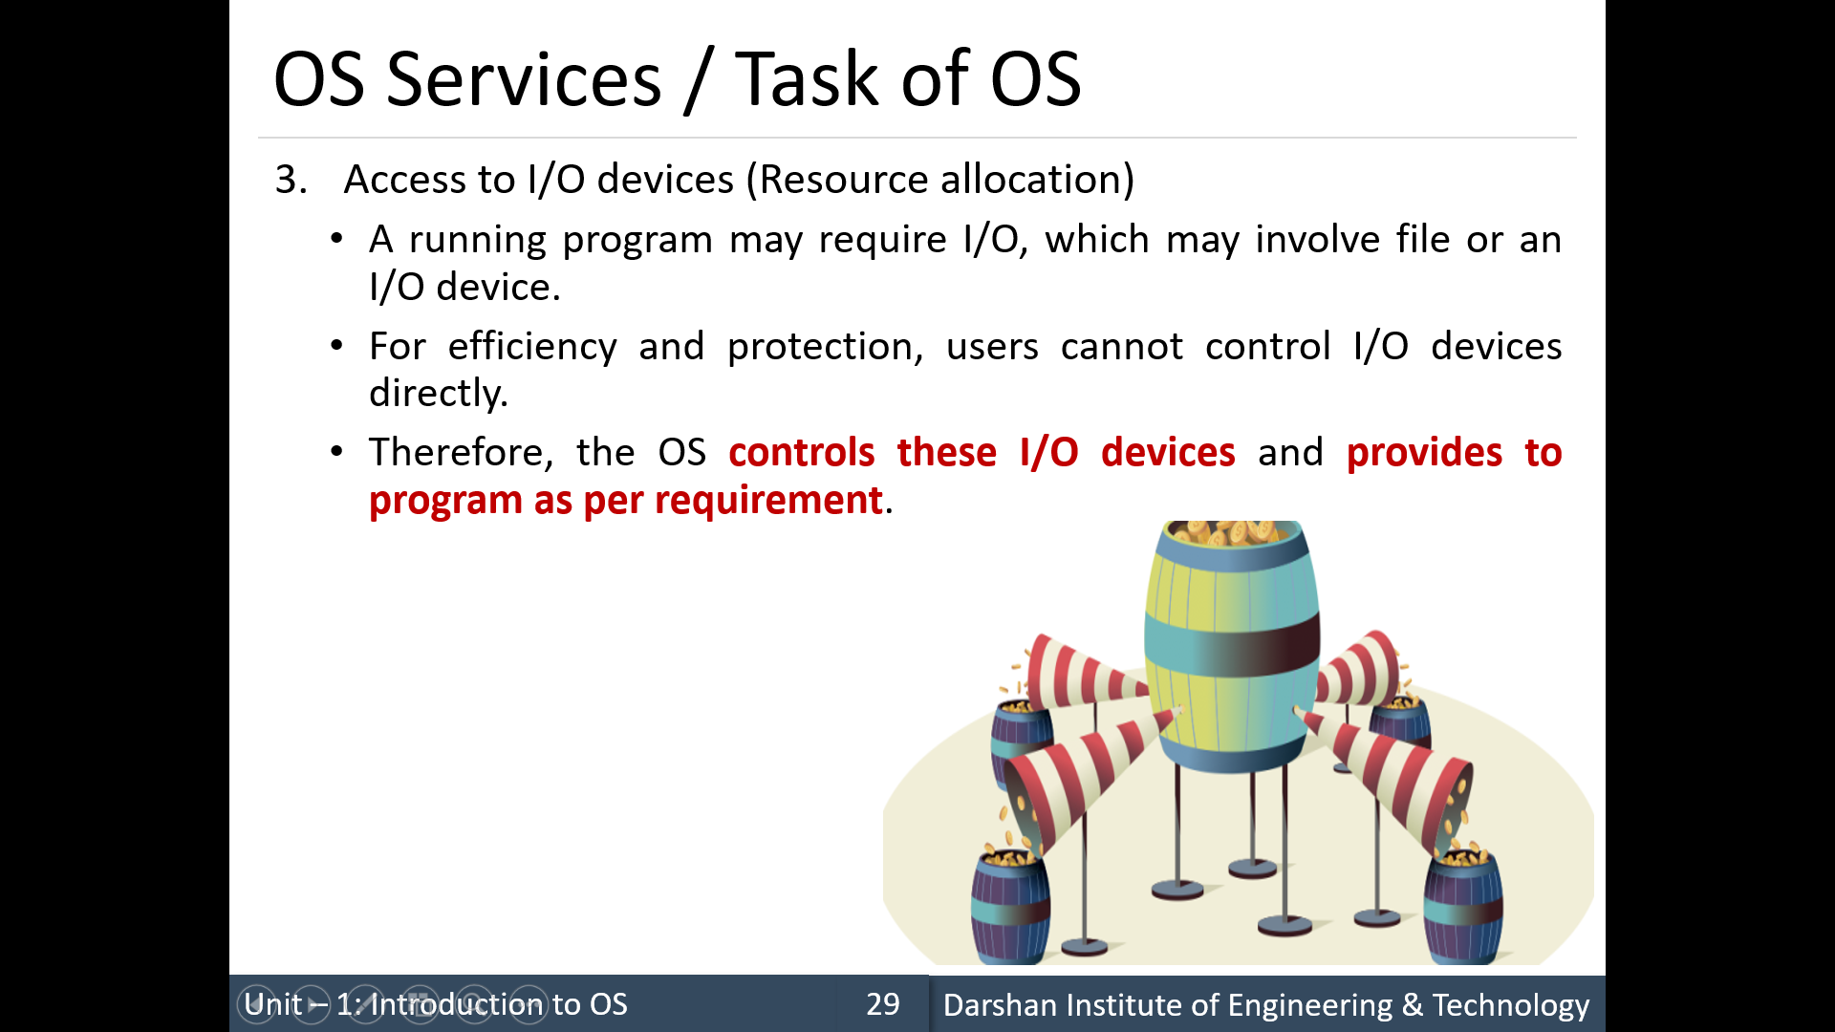
Functions

Slide 39
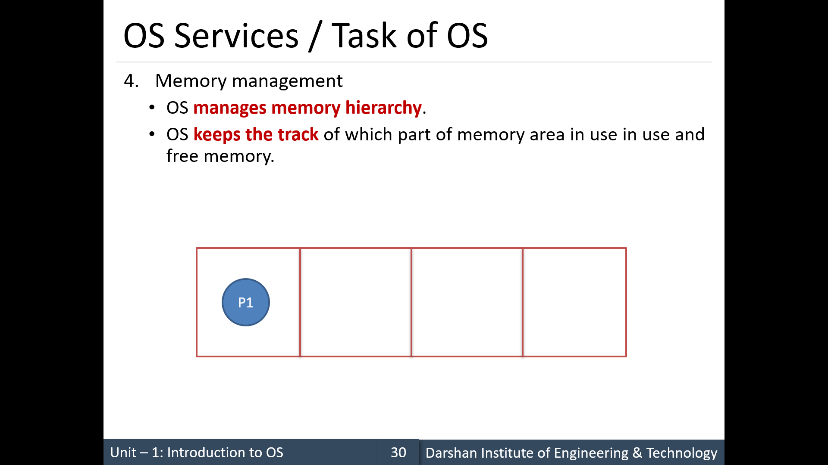
Functions

Slide 40
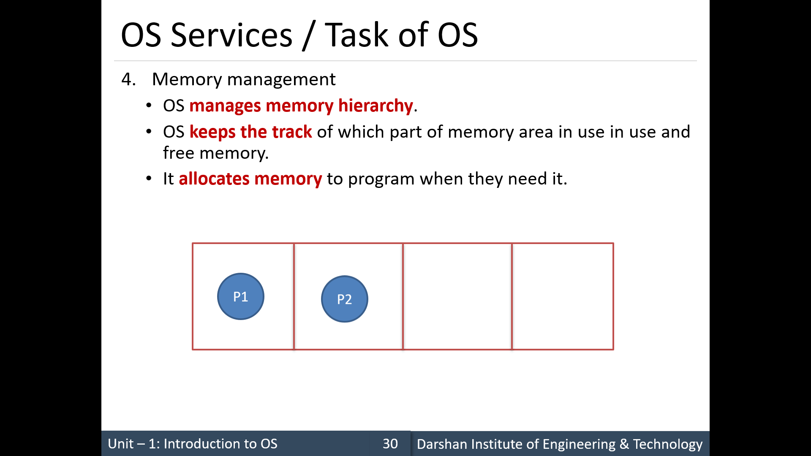
Functions

Slide 41
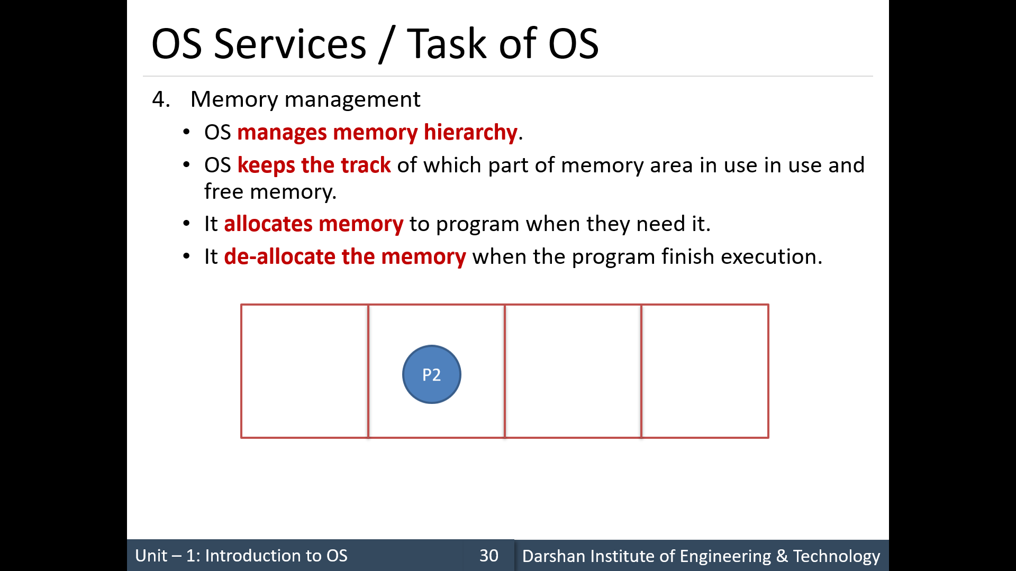
Functions

Slide 42
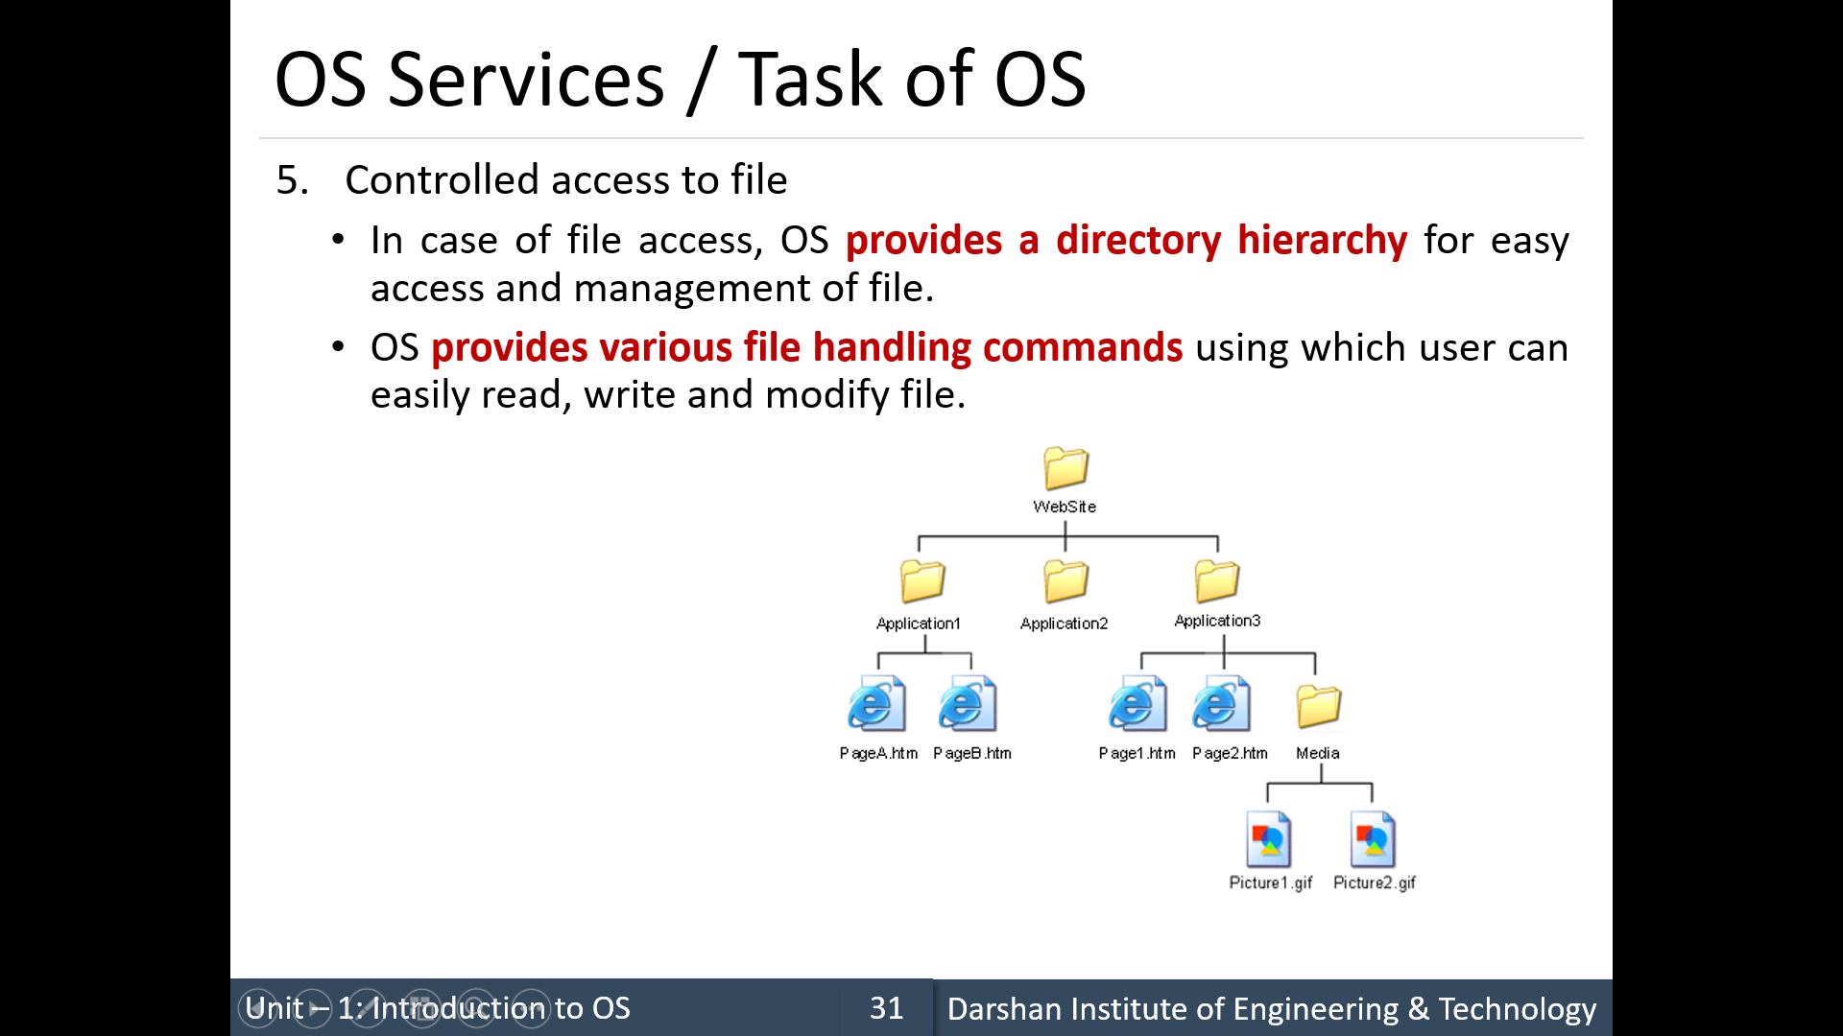
Functions

Slide 43
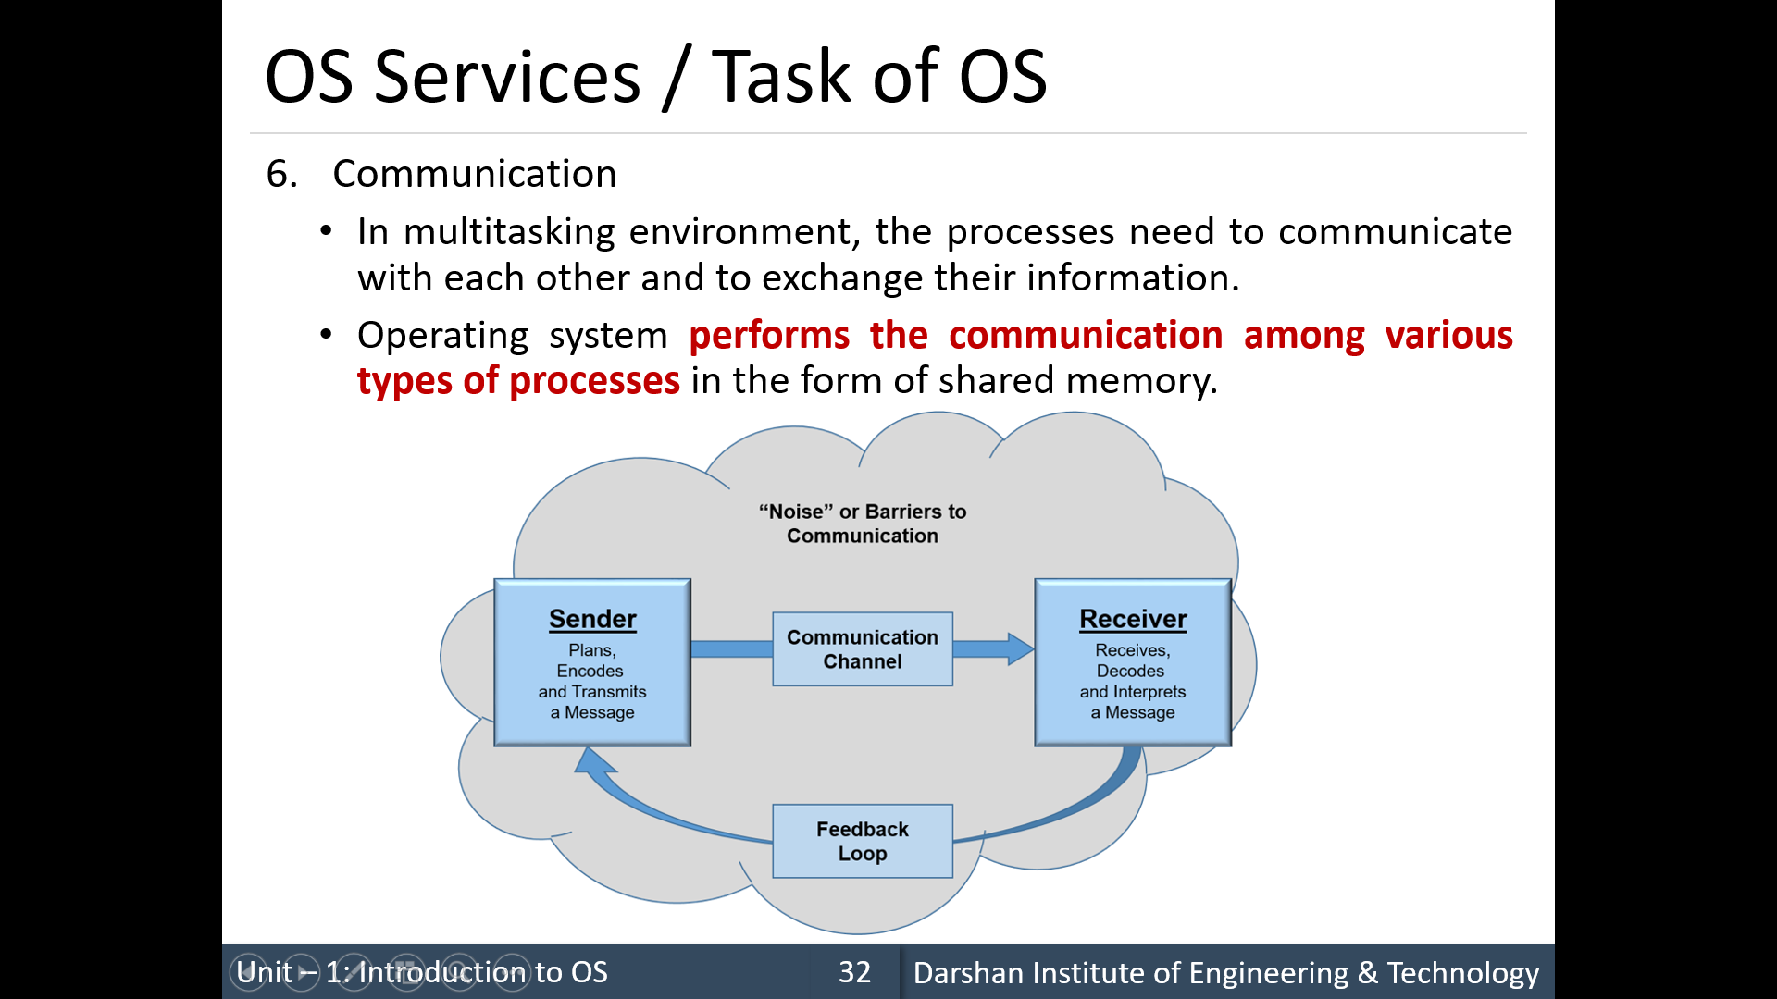
Functions
/message passing.

Slide 44
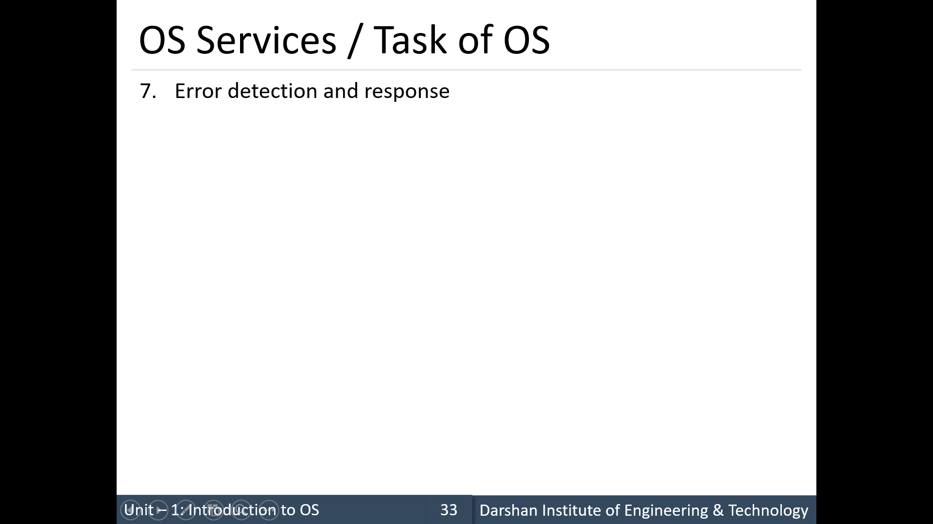
Functions
Errors that may occur in the system can be in
the CPU and memory hardware (such as a memory error or a power failure),
I/O devices (such as a parity error on disk, a connection failure on a network, or lack of paper in the printer),
the user program (such as an arithmetic overflow or an attempt to access an illegal memory location).

Slide 45
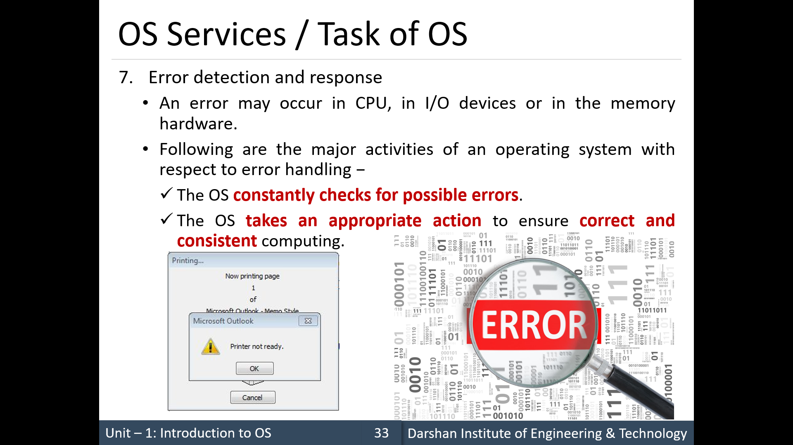
Functions

Slide 46
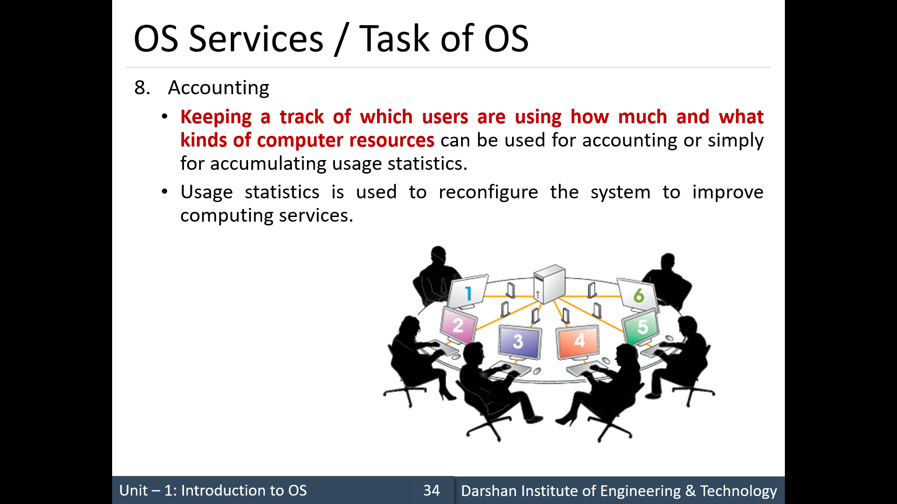
Functions
/Logging

Slide 47
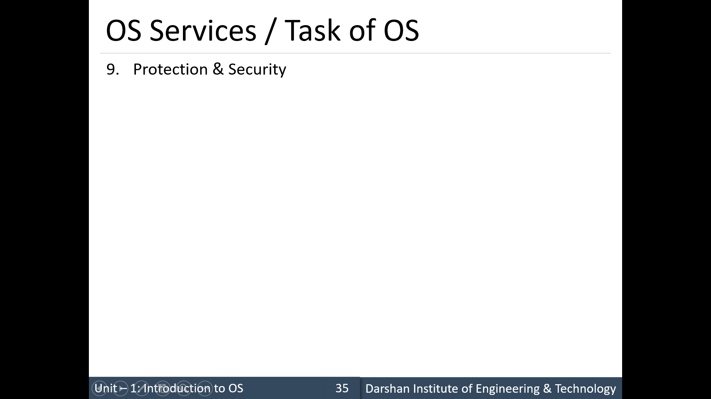
Functions
When several separate processes execute concurrently, it should not be possible for one process to interfere with the others or with the operating system itself.
Protection must be ensured.

Slide 48
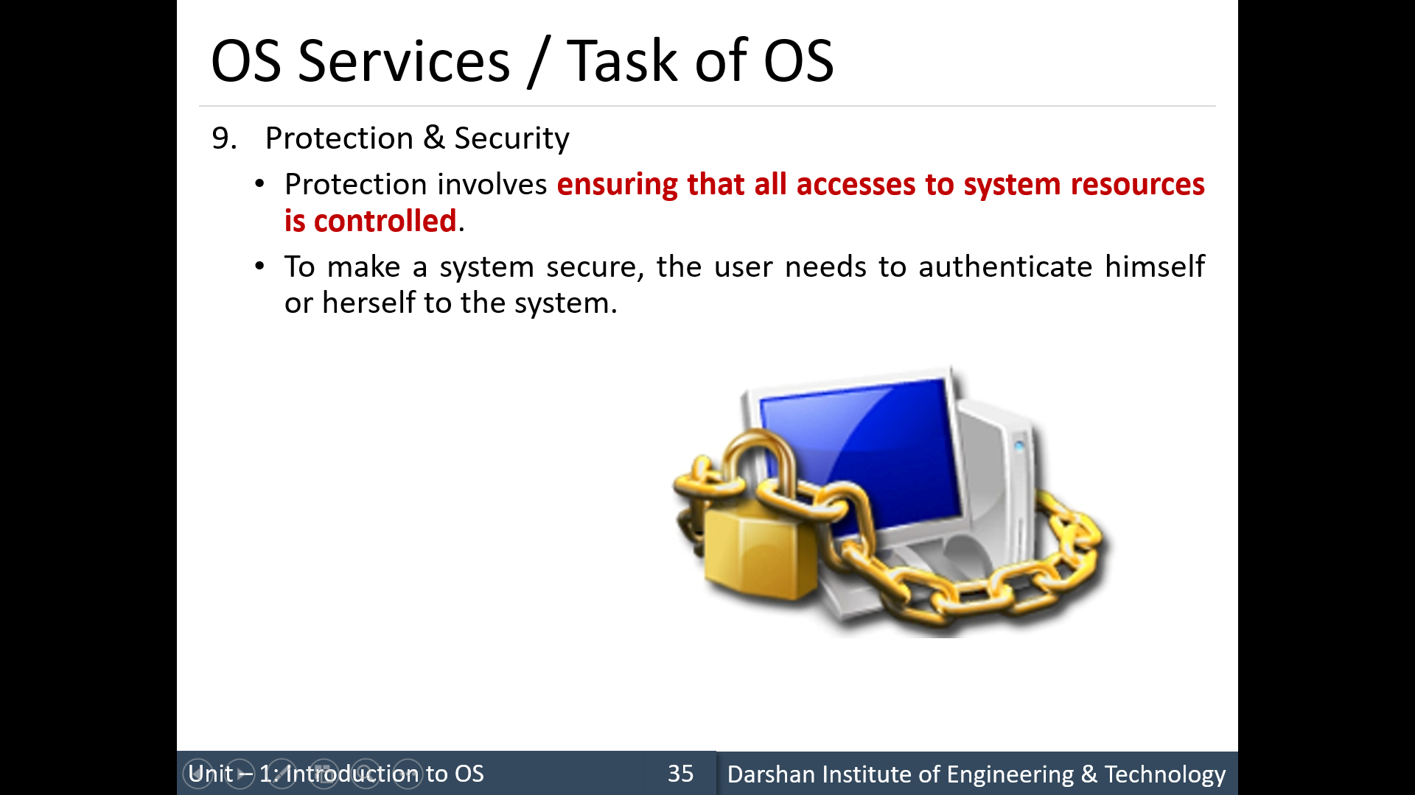
Functions
This is done usually by means of a password, to gain access to system resources.
It extends to defending external I/O devices, including network adapters, from invalid access attempts and recording all such connections for detection of break-ins

Slide 49
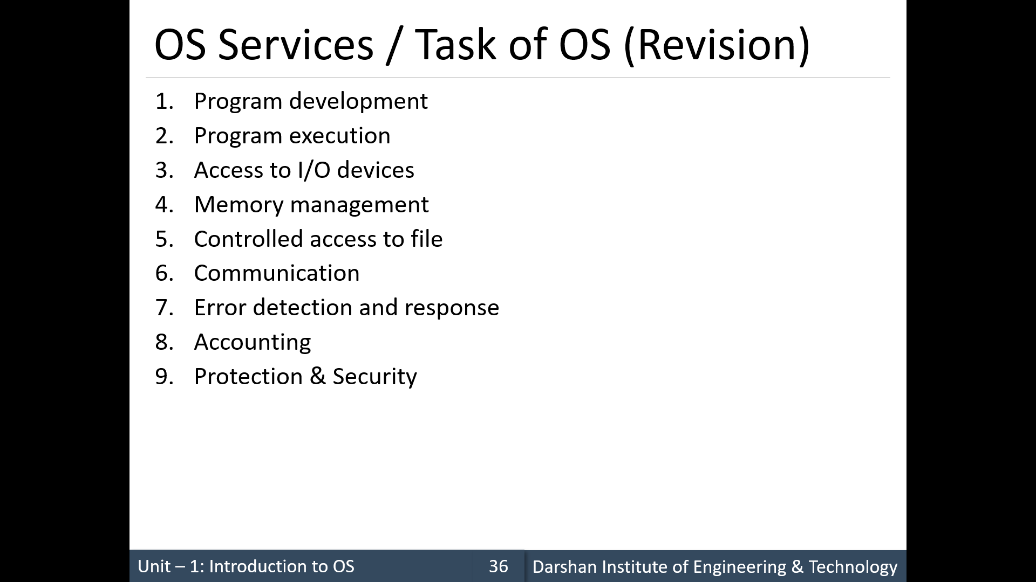
Functions

